Slide 1

Dietetics Regulation and Education in Malaysia
Barakatun Nisak Mohd Yusof, PhD
Associate Professor
Universiti Putra Malaysia
bnisak@upm.edu.my

Slide 2


Acknowledgements
Professor Winnie Chee Winnie Chee, PhD, FNSM,FMDA
Professor, Nutrition & Dietetics, IMU
President, Malaysian Dietitians’ Association

Slide 3

Overview of Presentation
Dietetics Profession in Malaysia – role, profile & qualification
Registration status of dietitians in Malaysia
Curriculum & approaches to teaching learning
Challenges faced by the profession and in education & training of dietitians

Slide 4
Dietetics Profession in Malaysia

Slide 5

The dietetics profession in Malaysia
The Malaysian Dietitians’ Association describes a dietitian as:
A professional trained in translating the science of food, nutrition and medical nutrition therapy to meet the needs of individuals or groups in disease or health
http://www.dietitians.org.my/about-dietitian/who-is-a-dietitian
Notes:
In fact those states and territories that WERE registered were DE-registered in the early 1990s for the introduction of SR.

Slide 6
Who is Dietitian (Pegawai Dietetik) in Malaysia?
The Registered Dietitian is professionally trained to translate current science of food and nutrition to enable individuals and groups to make appropriate lifestyle and food choices to meet nutrient requirements in health and disease.
The dietitian provides nutrition care including nutrition assessment and diagnosis; prescribe medical nutrition therapy, monitor and evaluate outcomes; and plans, manages and ensures the provision of nutritious, safe and quality foods.
Dietitians may work in a variety of settings such as government, private, education and research, industry, sports, media, long term care facilities, non-government organisations, digital organisations and others.

Slide 7
Who can work as a Dietitian in Malaysia?
Obtain a 4 year undergraduate degree in Dietetics (with integrated Internship ~ 1200 hours) as the following:
  Bachelor of Science in Dietetics or
  Bachelor of Science in Nutrition & Dietetics
Obtain postgraduate degree in Dietetics (with integrated internship) e.g. entry level Masters in Dietetics
Overseas dietetics degrees - with adequate internships hours* or possess Registered Dietitian status from overseas are recognised as Ordinary members of MDA.
Employment is not governed by MDA
*>500 hours (MDA AGM 2018)

Slide 8
Current employment of dietitians in Malaysia
55% → Government-related health sectors
20% → Private health sectors
15% → Academia and Research
5% → Business & food industry
5% → Food Services

Slide 9
Developmental Milestone of Dietetics Profession
Formation of National Dietetic Association → Malaysian Dietitian Association
Education standards & competencies
Registration status of dietitians

Slide 10
Establishment of Malaysian Dietitian Association (MDA)
1994
Established in 1994
22 Mar. 1996
Official launched on March 22, 1996 at Nikko Hotel, KL by Minister of Health, Dato Chua Jui Meng

Slide 11
Functions of Malaysian Dietitians’ Association
1.Common Vision & Goal
Aggregate efforts, thoughts & ideas
2.Legal function & visual identity
Structure & governance to the profession
3.Promote visibility & credibility
4. Powerhouse for professional expertise
5. Advocate for provision of quality care to patients/clients
6. Communication with stakeholders & public
7. Lead in professional matters and needs of the members to benefit the public

Slide 12

Registration of Dietitians in Malaysia
An Act to provide for the establishment of the Malaysian Allied Health Professions Council, to provide for the registration of persons practising as an allied health practitioners and to regulate the practice of the allied health professions and for related matters.
Define criteria for registration with and certification by the professional regulatory body,
Provide guidance to members in the form of codes of ethics, rules of professional conduct and standards of practice,
Maintain a public register which contains information about individuals registered with the professional, and
Investigate complaints about members and discipline members as required

Slide 13
Registration of Dietitians in Malaysia: Allied Health Professions Act 2016
Registration Certificate
Practising Certificate
Renewal of Practising Certificate
Application for Registration
Code of Professional Conduct
“Allied Health Professions information System”
20 CPD points

Slide 14
Code of Ethics & Professional Conduct
Principles:
Do No Harm , Benevolence, Fairness, Respect, Patient Autonomy
Responsibility
Client Privacy
Integrity
Client’s Rights
Professional conduct & competency
Continuous professional development
Scope of practice
Communication skills
Informed Consent
Documentation
Advertisement
Adherence to other code and laws

Slide 15
Education Standard in Malaysia

Slide 16








Undergraduate Level Dietetics
4-year course
7 universities
History of 31 years of dietetics education

Slide 17
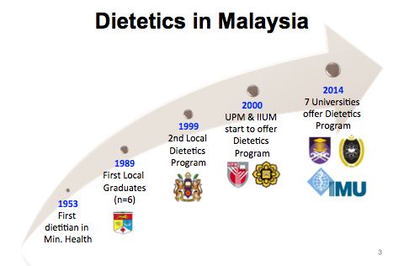
Notes:
Academic year - Academic calendar
Courses - Credit hours
Evaluation - Registration

Slide 18
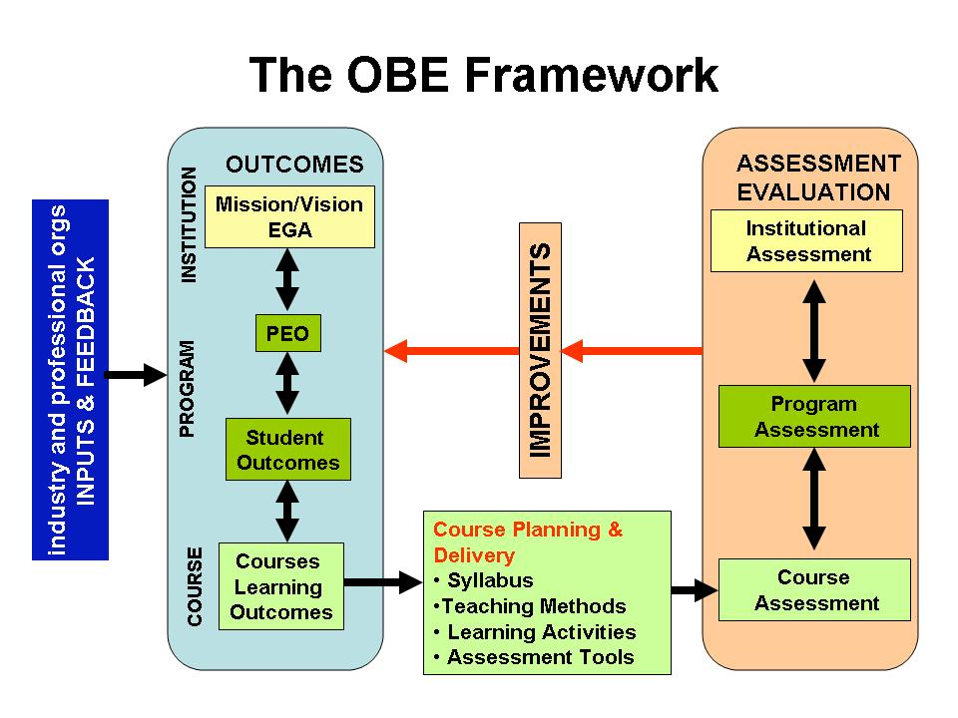

Slide 19

Dietetics curriculum require placements across 3 areas:
Provision of Service and application of knowledge
Developing practice and application of research
Adopting an evidence-based approach to dietetic practice
Communication
Quality in practice
Continued competence and professional accountability
Food Service Placement
160 hours
Community Dietetics
160 hours
Clinical Placement 800 hours
TOTAL 1240 hours

Slide 20
Courses in Dietetics Programmes
Groups | Courses
Basic sciences | Anatomy and Physiology Basic Pathology/Pathophysiology Pharmacology Immunology Genetics Biochemistry /Clinical Biochemistry Microbiology/Food microbiology
Food | Food Science Food Preparation Catering and Food Service Management
Social | Developmental Psychology Behaviour Counselling Nutritional Anthropology
Nutrition | Nutrition and Health Nutrition in Lifecycle Assessment of Nutritional Status Nutrition Education/Promotion
Dietetics | Medical Nutrition Therapy
 | Therapeutic Diet Preparation
 | Food Service Placement (160 hours)
 | Clinical and Community Dietetics Placement (800 hours OR 20 weeks)
Research | Research Methodology
 | Biostatistics/Epidemiology
 | Seminar
 | Research Project
University modules | Electives
 | Soft skills, communication, community service

Slide 21
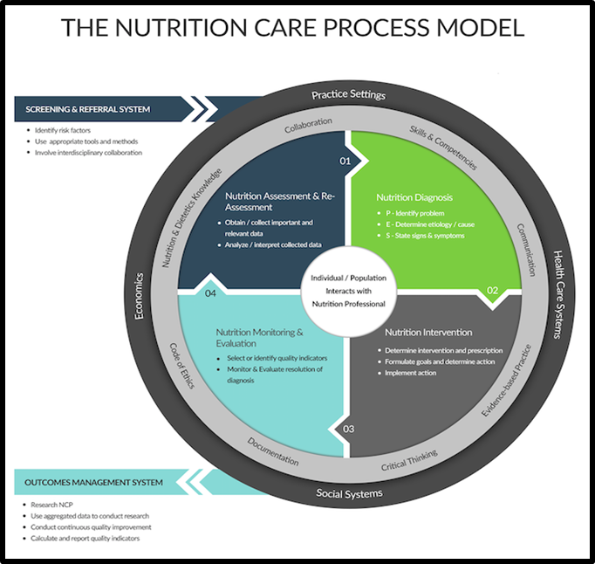
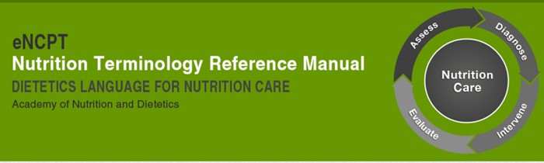
Nutrition Care Process and Standardised Language
All students and faculty have FREE access to eNCPT as subscribed by Malaysian Dietitians’ Association

Slide 22
2018 Learning Outcomes for Malaysian degree programmes incl. DIETETICS
Cluster 1 | Knowledge & Understanding
Cluster 2 | Cognitive Skills
Cluster 3 | Functional Work Skills Practical skills Interpersonal and Communication Skills Digital and Numeracy Skills Leadership, Autonomy and Responsibility
Cluster 4 | Personal and entrepreneurial skills
Cluster 5 | Ethics and Professionalism

Slide 23
Future competencies of dietitians?
Multi-skilled
Problem solver
Working to full scope of practice
Independent practitioner
Case manager
Good with data analytics
Techno savvy
An inter-professional practitioner
A team player ++
Personalised health
With the community
Hospital in the home - reduced focus in acute care
Food systems – sustainable foods & nutrition
Ref: Sandra Capra 2016

Slide 24
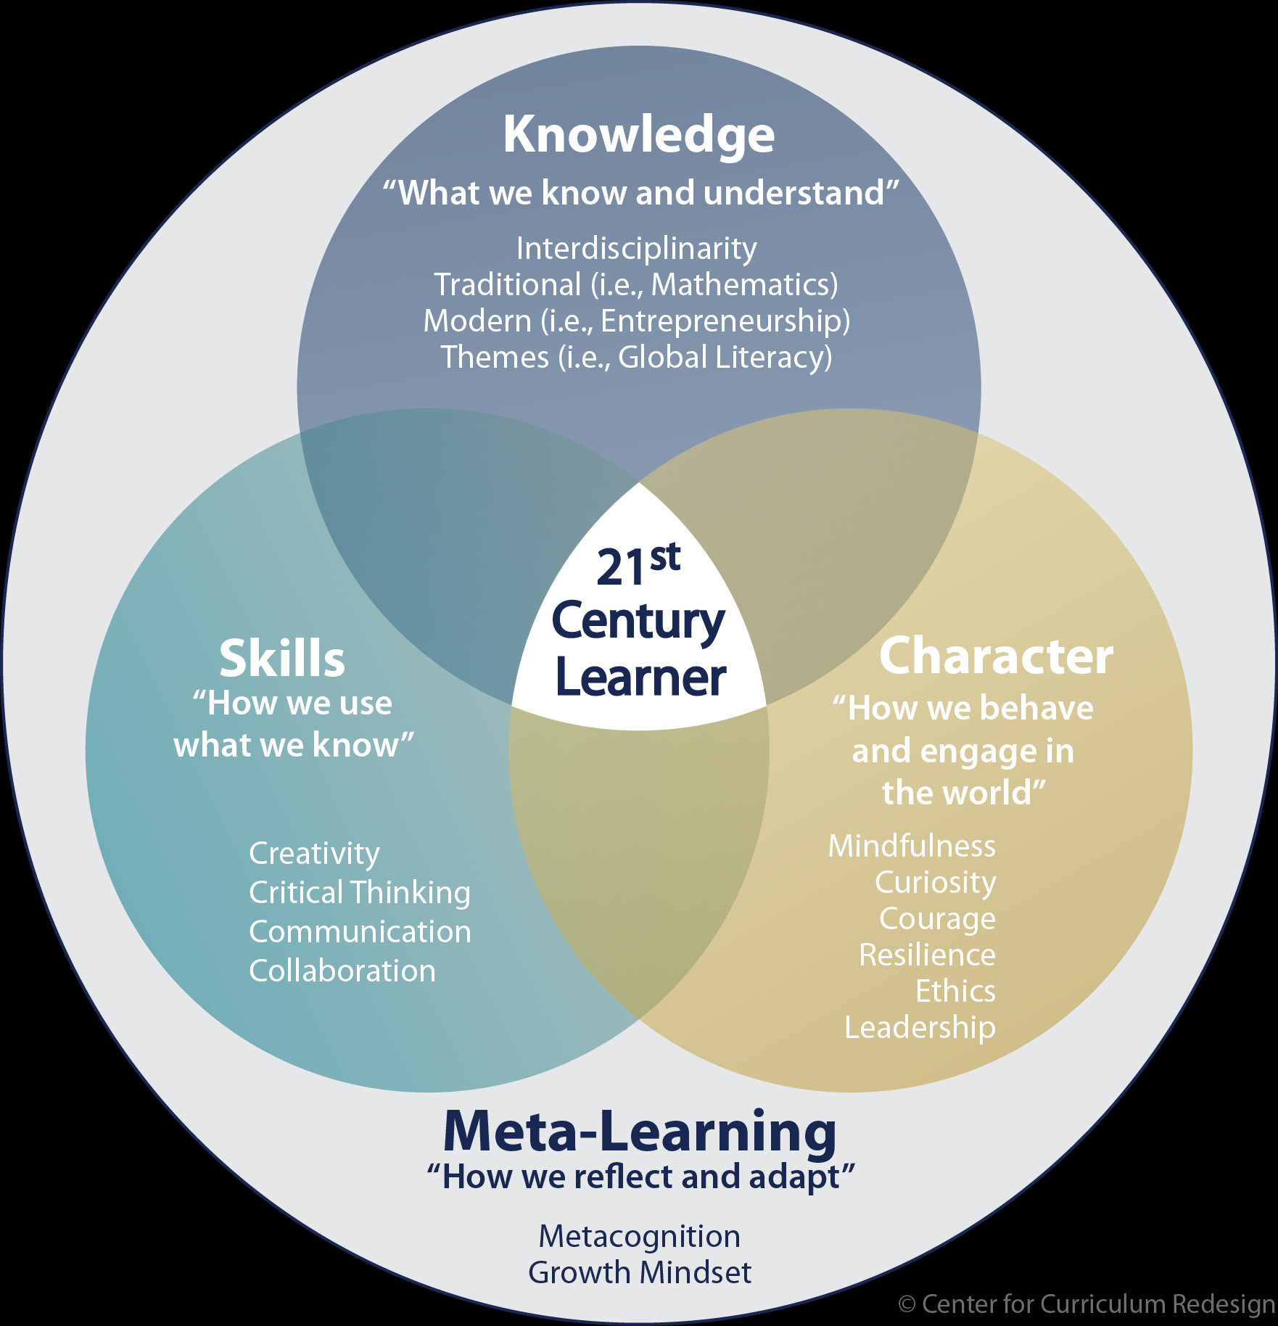
What needs to transform in the dietetics curriculum?
Emphasis on 4Cs in students –
CREATIVITY
CRITICAL THINKING
COMMUNICATION
COLLABORATION
Make digital literacy, data analytics education compulsory
Develop educational content in collaboration with community
Reform content & deliver teaching via DIGITAL platforms
Introduce entrepreneurship & the ART of dietetics!

Slide 25
Challenges In Dietetics Education
Internship hours do not commensurate with competence
Critical Thinking
Communication Skills especially inter-professional communication
Training Millennials – “just in case vs just in time” knowledge & skills
Faculty development
Expectations of employers
Employability
Additional Skills
Specialisation
Double qualifications – entrepreneurship & business, food photography, fitness, culinary,

Slide 26

Task Force Dietetics Education (TFDE)

Slide 27
Program Structure in Universiti Putra Malaysia

Slide 28

Program Goal – Graduates that;
Knowledgeable and Have Comprehensive Skills In The Field of Dietetic
Professional and Ethical in the Practice of Clinical Nutrition, Institutional Food Services Management And Community Dietetics.
Have Communication Skills and Competence in Socio-cultural Aspects, Social Networks and Applying Entrepreneurial Elements in the Dietetic Field.
Capable of Conducting Research that can contribute to advances in the Dietetic Field.

Slide 29
Entry into the Program
SPM / O-Level
Pre-U (ASPER)
STPM / A-Level
Matriculation
Diploma
Shortlisted for Interview per admission requirements
International candidates
Enrollment

Slide 30
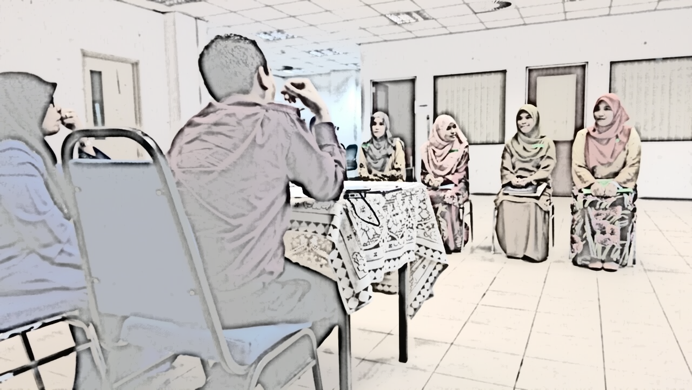
Interview Session

Slide 31

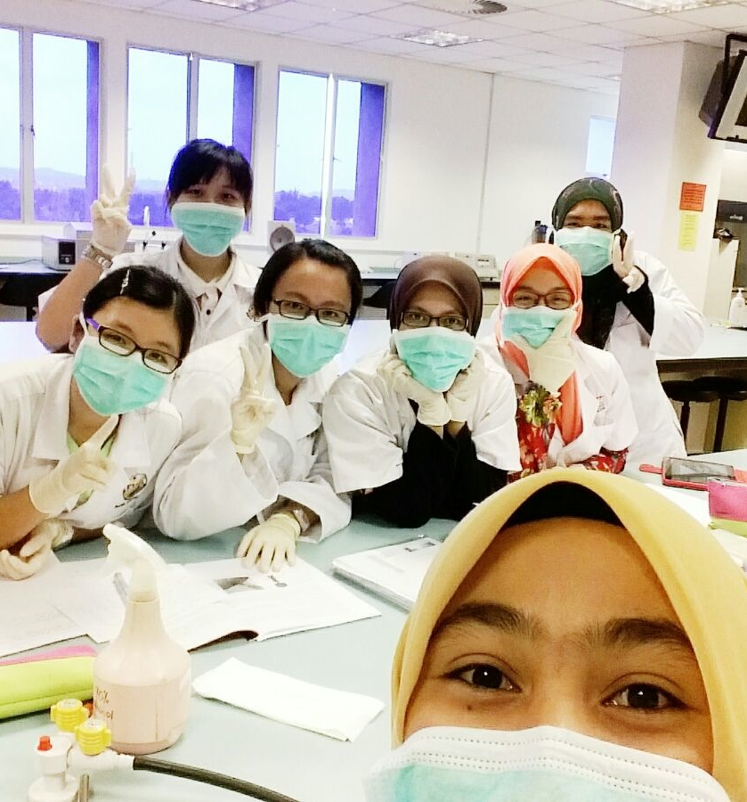
CURRICULUM STRUCTURE
4 year program (Total 140 credits→ 138 + 2 credits kokurikulum)
Integration of 6 semesters of courses and 30 weeks (1200 hrs) of Dietetics Professional Training in the areas of clinical nutrition, institutional food service management, community dietetics
Notes:
i. Jangkamasa Program Bacelor Dietetik (Kepujian) ini akan dijalankan dalam tempoh lapan (8) semester dengan 140 jam kredit, termasuk dua (2) jam kredit ko-kurikulum untuk bergraduat.

Slide 32
Program Schema Bachelor Sciences Dietetics With Honours
SEMESTER 1 | SEMESTER 2 | SEMESTER 3 | SEMESTER 4
Anatomy and Human Physiology | Principle of Food Preparation | Pathophysiology and Clinical Disease Management | Institutional Foodservice Management II
Basic Medical Microbiology | Basic Nutritional Immunology | Assessment of Nutritional Status and Health | Introduction to the Hospital Management
Agriculture and Man | Nutrition throughout Lifecycle | Institutional Foodservice Management 1 | Medical Nutrition Therapy 1
Malaysian Nationhood | Genetic and Nutrition | Food, Society and | Biostatistics and Research Methodology
Islamic Civilisation and Asia Civilisation | Nutritional Biochemistry | Maternal Health and Child | Basic Epidemiology
Ethnics Relation | English (Academic Interaction and Presentation) | Academic Writing | Nutrition and Health Promotion
Curriculum | Basic entrepreneurship | Curriculum | Elective (Global Language)
SEMESTER 5 | SEMESTER 6 | SEMESTER 7 | SEMESTER 8
Seminar: Current Development in Dietetics | Nutrition Care Process | Professional Dietetics Practicum (Clinical) | Professional Dietetics Practicum (Community)
Nutrition Counselling and Patient Education | Medical Nutrition Therapy II |  | Professional Dietetics Practicum (Elective Clinical Placement)
Professional Behaviour Practices | Sport Nutrition
Medical Nutrition Therapy II | Bachelor Dissertations
Nutrition, Physical Activity and Exercise | Elective
Health and Geriatric Nutrition | Elective
Bachelor Dissertation | Professional Dietetics Practicum (Institutional Foodservice Management)

Slide 33
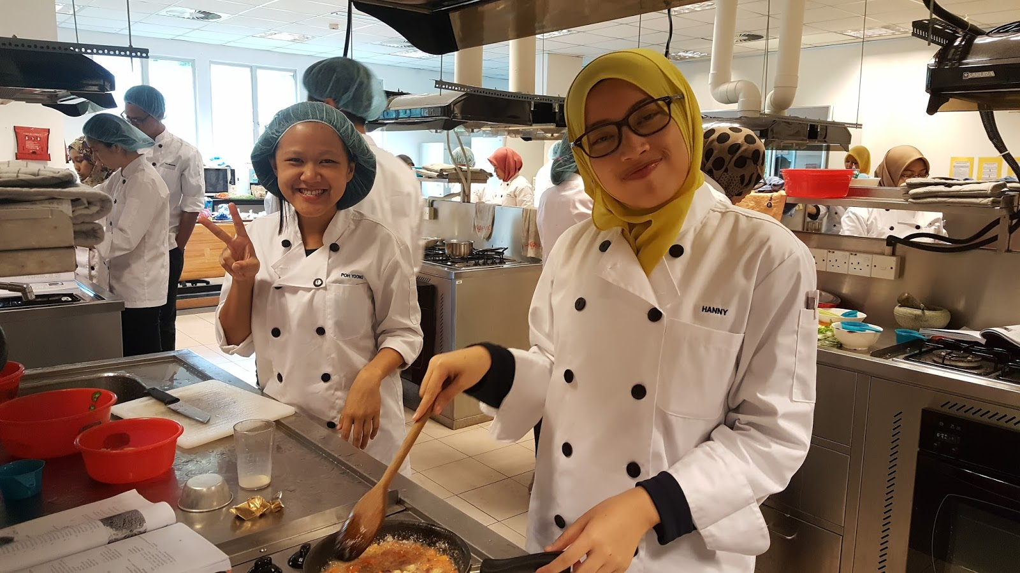
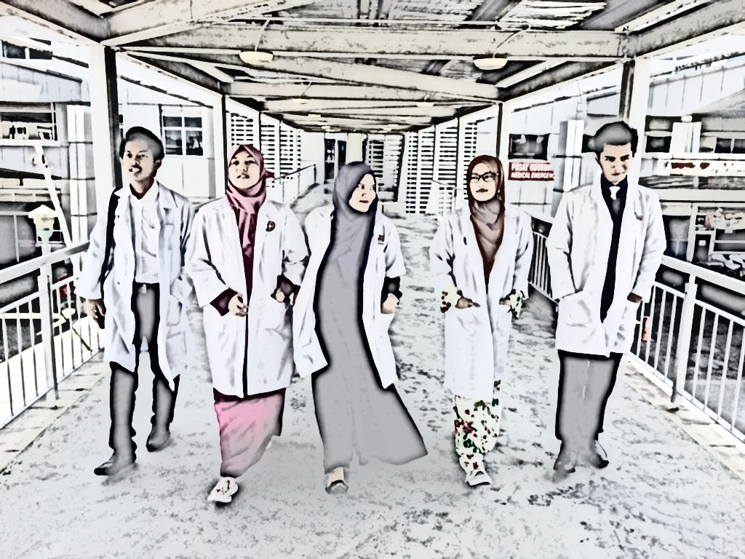
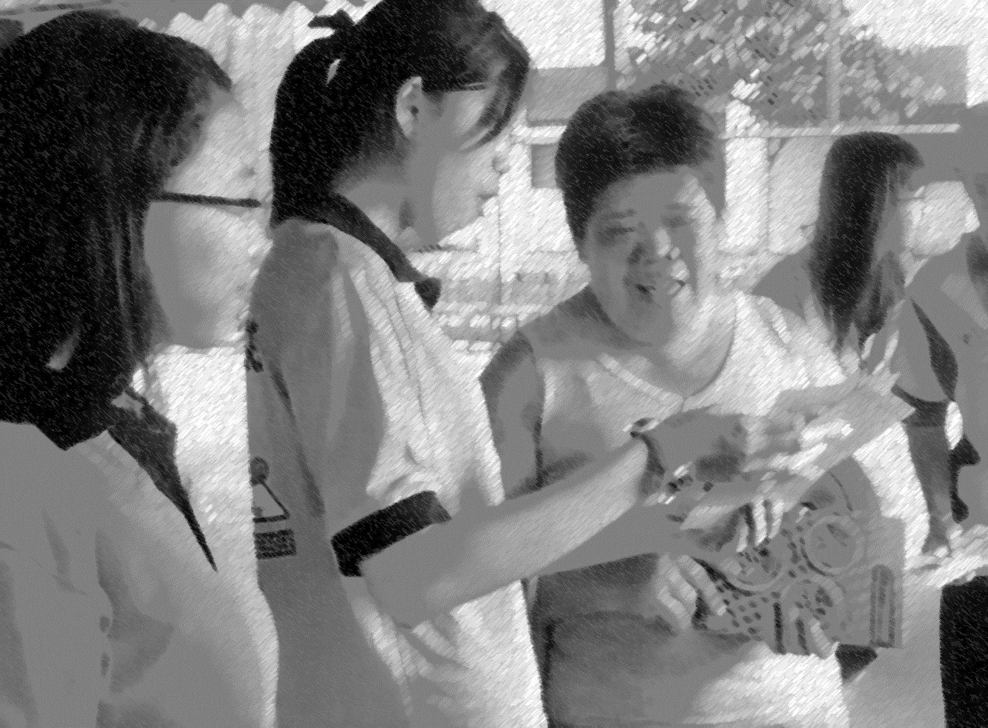
Professional Training
Institutional Food Services
(4 weeks ~ 160 hrs)
Professional Dietetics Practicum
(30 weeks ~1200 hrs)
Community
(6 weeks ~ 240 hrs)
Clinical
(14 weeks ~ 560 hrs)
Elective Clinical Placement
(6 weeks ~ 240 hrs)

Slide 34
Conclusion
Dietetics profession is well developed in Malaysia with new opportunities for growth
Registration of dietitians will ensure higher standards of practice and quality but delay in implementation in Malaysia
Challenges in raising standards & profile of dietetics profession
Programme standards & innovative teaching are well established in Malaysian dietetics curriculum
Challenges with competency levels and employability of graduates

Slide 36
Thank you

